Slide 1


COP 5725
School of Computer and Information Sciences
Welcome to Fast Forward
3 Minutes per person.

Slide 2
COP 5725
School of Computer and Information Sciences
Each person not presenting, should complete the google form located at:

Slide 3
COP 5725
School of Computer and Information Sciences
Each person not presenting, should complete the google form located at:

Slide 4
COP 5725
School of Computer and Information Sciences
A K M Iqtidar Newaz (Individual)
A Survey on Cassandra – A Decentralized Structured Storage System

Slide 5
Introduction
What?
A Survey on Cassandra – A Decentralized Structured Storage System
Why?
High Scalability
Fault Tolerant
High Availability
Support for continuous growth
How?
Literature review and classification.

Slide 6
Elevator-Pitch
Literature review of decentralized storage system on database management system.
Classification and Dynamicity of Cassandra available for database management based on features, techniques, etc.
A relative comparison of centralized and decentralized storage system .
Shortcomings of different database storage system comparing to Cassandra.

Slide 7
Deliverables
What to expect at the end?
A survey on Cassandra – Decentralized Structured Storage System
What is your contribution?
Literature review of Different Storage System and classify them according to features, techniques, etc.
Shortcomings of different approaches.
How many hours a week starting today would you spend in this project?
10 hours
How does this measures the outcome?
Empirically Demonstrate how Cassandra support high update throughput while delivering low latency.
How many references would you have?
Between 60-70

Slide 8
COP 5725
School of Computer and Information Sciences Adnan Maruf，Liqun Yang
Storage & Management of 3D Geometric Models

Slide 9
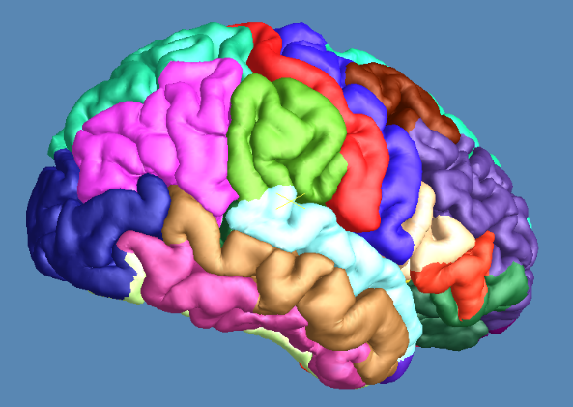
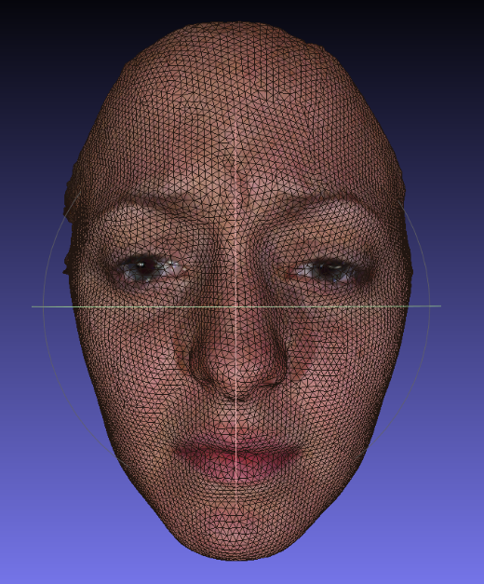
Introduction
Project Description: Store 3D models using database and manage the geometric properties of the models.
Geometric Properties:
Genus/Handle
Boundary
Non-Manifoldness
Isolated vertices
Vertex neighbors
Vertex and Face color Info
Vertex normal
Curvatures
Parameterized Info
And many more
Brain: 150K Vertices, 300K Faces
Face: 10K Vertices, 15K Faces
Managing the Models:
Compute the Geometric properties
Insert/Update/Delete the properties
Delete Vertex and Face
Adding/Removing new & existing models

Slide 10
Importance
Current Way:
Every model is stored in separate file.
Multiple file formats (.off, .m, .obj, etc.)
Properties are either stored in separate file or calculated every time.
Difficult to compare the models with multiple properties.
This Solution:
All models are stored in the database.
Easy to handle multiple file formats i.e. conversion would be super easy.
Easy to query for search and comparison.
Properties are stored in a structured way.

Slide 11
Deliverables
Expectation:
Design and Implementation of a working database capable of storing 3D models and geometry properties.
Design SQL queries capable of computing some geometry properties and managing the models.
Hours per Week:
10 hours+ per week per member.
Comparison:
We will provide some comparison with existing systems. For example: File format conversion functions.
Reference Count:
Technical Report: 5-10 refs.

Slide 12
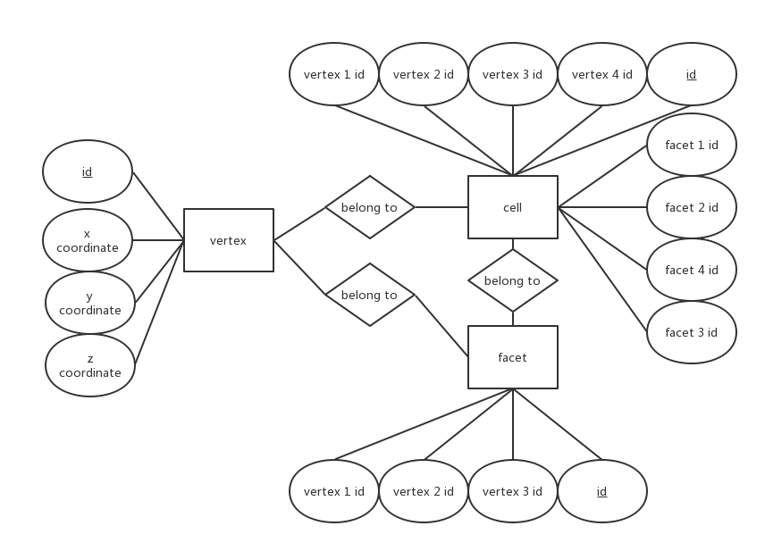
Project plan
1. Store the 3D-models with their inner structure.
2. Provide some useful operation in the research of computer graphics by SQL and relational algebra.

Slide 13
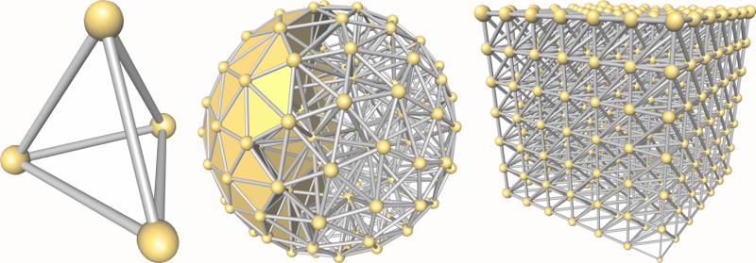
SQL geometry calculation
Notes:
SQL is a perfect implementation of Set theory and Set Theory is one of the fundamental of modern mathematic, which means, on the theory, SQL can be used in any aspect of calculation.
For this project the most contribution is we try to use SQL to do some geometry calculation. It is meaningful and novel. Maybe finally, we can only get a prototype system of our exploration but I do believe that it could be a fantastic beginning to link database theory and computer graphics.

Slide 14
Example
If the following schema is built, how to find the public vertex of facet 1 and facet 2?
create table v (id int, x double, y double, z double);
create table f (id int, v1 int, v2 int, v3 int);
select x,y,z
from v
where id in(
select f1.v1
from f as f1,f as f2
where (f1.v1 = f2.v1 or f1.v1 = f2.v2 or f1.v1 = f2.v3) and (f1.ID = 0 and f2.ID = 1)
union
select f1.v2
from f as f1,f as f2
where (f1.v2 = f2.v2 or f1.v2 = f2.v3) and (f1.ID = 0 and f2.ID = 1)
union
select f1.v3
from f as f1,f as f2
where (f1.v3 = f2.v3) and (f1.ID = 0 and f2.ID = 1)
);

Slide 15
COP 5725
School of Computer and Information Sciences
Carlos Arosemena
MongoDB Sharded Clusters

Slide 16
Introduction
Sharded Clusters are how MongoDB replicates data on different servers
Distributing data horizontally is a great way to increase performance
A MongoDB Sharded Cluster must be planned and configured on a set of servers

Slide 17
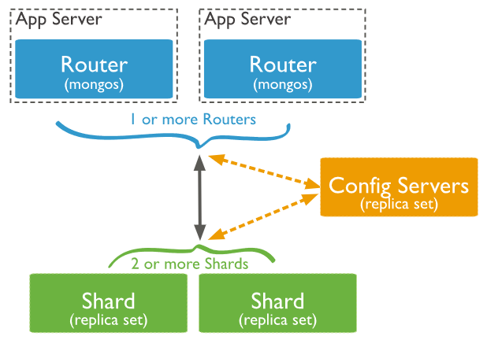
Elevator-Pitch
Sharded Cluster Diagram

Slide 18
Deliverables
What to expect at the end?
An overview and and introduction on what a MongoDB Sharded Cluster is
What is your contribution?
Giving a practical application on how to deploy this technology and what it is used for
How many hours a week starting today would you spend in this project?
A minimum of 4
How does this measures the outcome?
The class will gain knowledge of this technology and apply it on their future projects
How many references would you have?
At least 10-15. Although most of the information comes from the MongoDB documentation.

Slide 19
COP 5725
School of Computer and Information Sciences Richard Rodriguez
Qiulin Zhang
Juan Wang
Person Presenting: Qiulin Zhang
A Survey of DBMS Performance Improvements: B-Trees vs. Skip-Lists

Slide 20
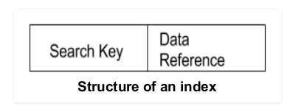
Index-Speed the search
A database index is a data structure that improves the speed of data retrieval operations on a database table at the cost of additional writes and storage space to maintain the index data structure.
Indices are used to quickly locate data without having to search every row in a database table every time a database table is accessed.

Slide 21
Elevator-Pitch
B-tree:
most commonly used
they do fewer disk I/O operations to run a lookup compared to other balanced trees.
Skip-List :
use probabilistic balancing rather than strictly enforced balancing
easy to implement, extend and modify

Slide 22
Deliverables
What to expect at the end? A Research Survey provides a perspective of existing work and far reaching about B-Trees and Skip Lists improving the database performance.
What is your contribution?Analysis and compare these two structures in DBMS performance.
How many hours a week starting today would you spend in this project? 15-25
How does this measures the outcome? I will go through and discuss plenty of papers with my group to research deeply with this topic.
How many references would you have? 45-60

Slide 23
COP 5725
School of Computer and Information Sciences Richard Rodriguez
Qiulin Zhang
Juan Wang
Person Presenting: Richi Rodriguez
A Survey of DBMS Performance Improvements: B-Trees vs. Skip-Lists

Slide 24
Introduction
What is it?
B-Trees is one method of indexing data in a database. There are other indexing methods, but B-Trees are preferred.
Why is it important?
Storing large amounts of data is impractical if searching and/or performing operations on it takes a lifetime. B-Trees work on logarithmic time, thereby decrementing the search time.
How? (Methodology)
B-Trees write large amounts of data to disk; they, however, use the efficiency of a binary search tree approach to minimize the wait on search operations. This has led to other variants of B-Trees, but even those variants behave like regular B-Trees.

Slide 25
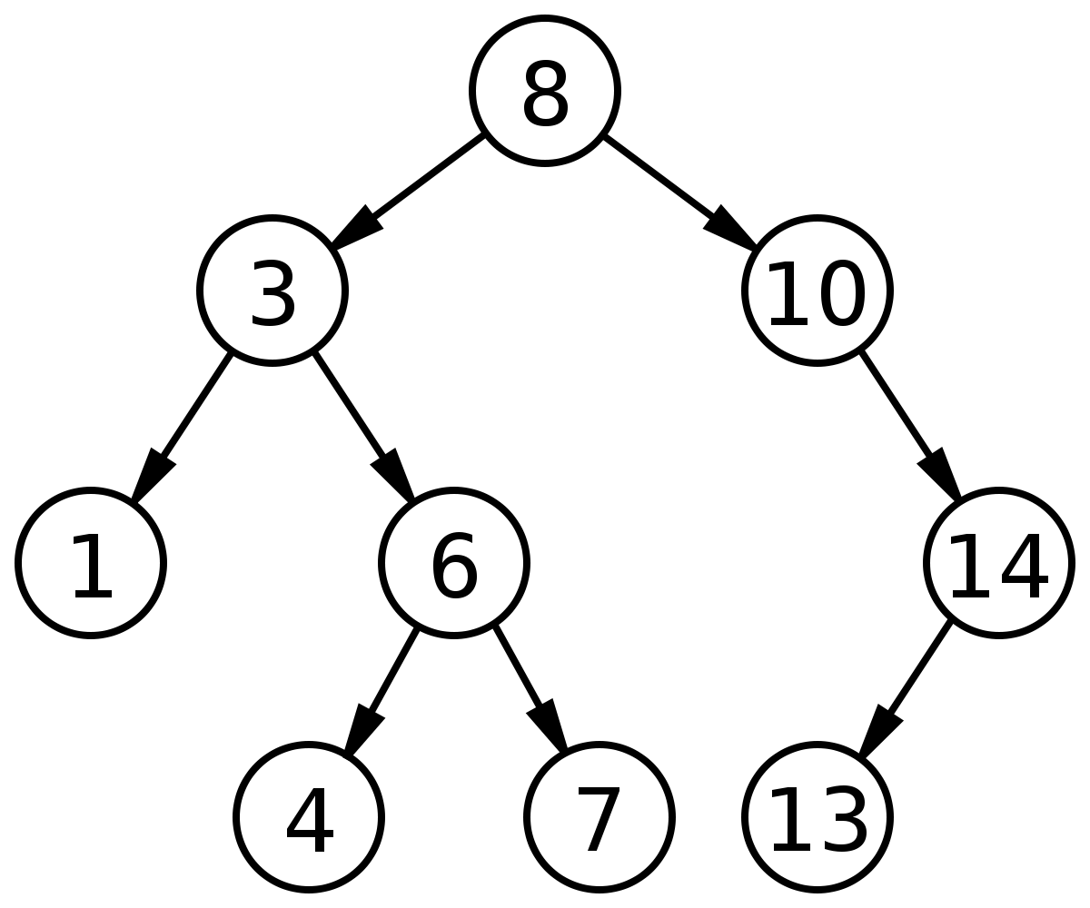
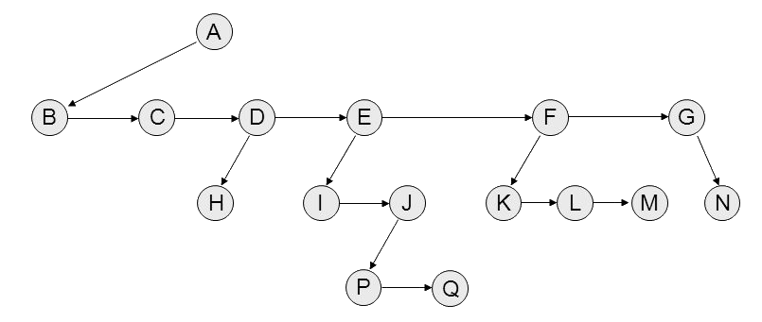
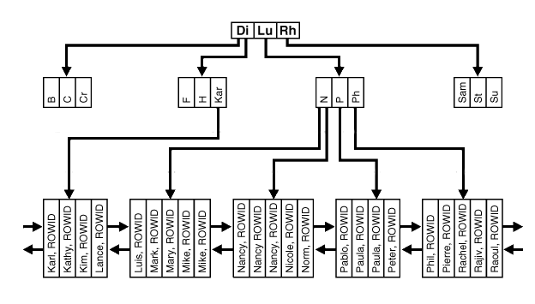
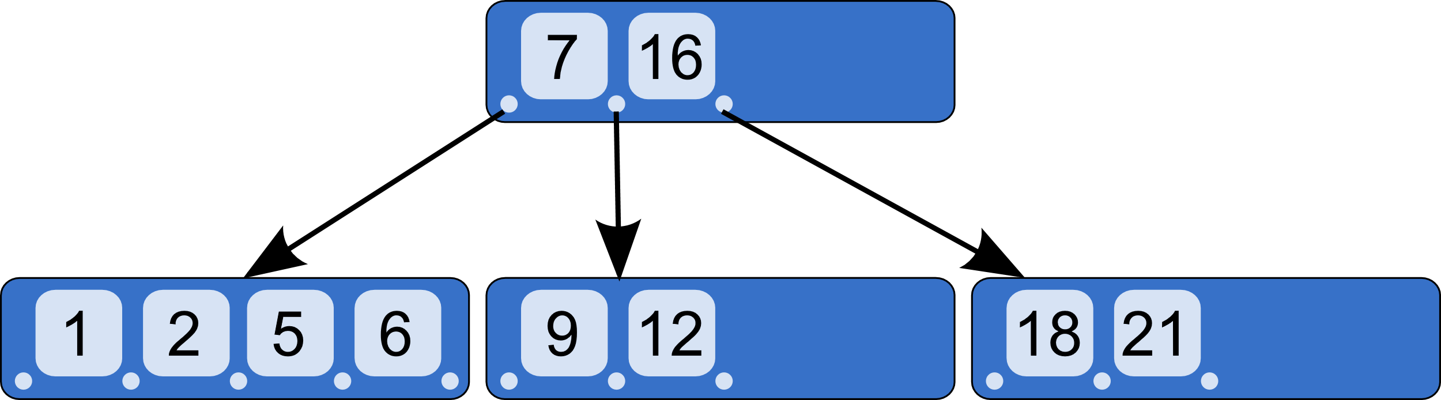
Elevator-Pitch
BST
Tree with Sibling Implementation

Slide 26
Deliverables
What to expect at the end? A research survey on how B-Trees and Skip Lists affect the performance of databases.
What is your contribution? My contribution will be researching B-Trees and B-Tree variants, and their overall performance.
How many hours a week starting today would you spend in this project? I plan to spend 15 hours per week on research.
How does this measures the outcome? The outcome of this research is proportionally related to the amount of time and research I place into it; therefore, the more time and effort I place into it, the better the research survey.
How many references would you have? I am planning on contributing between 30 and 35 references.

Slide 27
COP 5725
School of Computer and Information Sciences Richard Rodriguez
Qiulin Zhang
Juan Wang
Person Presenting: Juan Wang
A Survey of DBMS Performance Improvements: B-Tree vs. Skip Lists

Slide 28
Introduction
What is it?
A survey about Skiplist, a data structure used for indexing
Why is it important?
This data structure and its lockfree/non-blocking algorithms can be applied in modern indexing design with better performance.
How? (Methodology)
Reading research papers
Comparison test
Result analysis

Slide 29
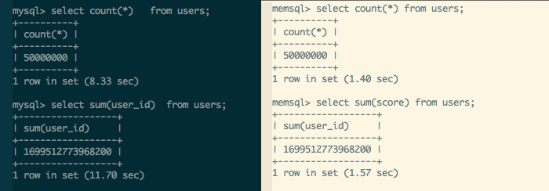
Elevator-Pitch
Skiplists are a relatively recent invention.
It’s a much simpler and more concise data structure to implement.
If you want to achieve thread safety under a concurrent workload, the lock free skiplist will be the best choice. It provides thread safety with better parallelism than thread-safe balanced tree that require locking.
A lot of research and prototyping went into the decision to use a skiplist. I hope to provide some of the rationale for this choice and to demonstrate the power of skiplist implementation.

Slide 30
Deliverables
What to expect at the end?
A survey paper shows advantages and disadvantages of both data structures, B-tree and Skiplist. Meanwhile, it finds out the certain application scene under which the one can outperform the other.
What is your contribution?
I am in charge of the Skiplist part.
How many hours a week starting today would you spend in this project? 15 hours per week
How does this measures the outcome?
The more work we do, the better result we get.
How many references would you have? around 30-35

Slide 31
COP 5725
A Survey on Intrusion Detection Systems for DBMS
Abbas Acar, Leonardo Babun, Amit Kumar Sikder
Cyber-Physical Systems Security Lab (CSL)

Slide 32


Introduction
What is it?
A survey of IDS methods on DBMS.
Why is it important?
How? (Methodology)
Review of different DBMS in the literature.
Background on IDS.
Notes:
-A hacker has stolen millions of user account details from popular education platform Edmodo, and the data is apparently for sale on the so-called dark web.
-Equifax hack has been marked as the worst data breach in US history. Attackers stole half the US population's Social Security numbers from Equifax database.

Slide 33
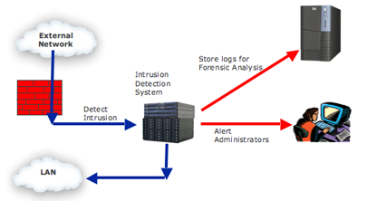
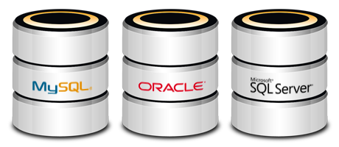
Elevator-Pitch
Background
What is DBMS?
What is IDS?
Traditional IDS Approaches
Signature-based IDSs
Anomaly-based IDSs
Notes:
Figure - A typical intrusion detection system using a network processor in IDS for signature matching

Slide 34
Deliverables
What to expect at the end?
A survey on Intrusion Detection Systems in DBMSs.
What is your contribution?
Background on DBMS and Related Work.
Traditional IDS approaches.
How many hours a week starting today would you spend in this project?
~10 hours
How does this measures the outcome?
A publishable survey paper.
How many references would you have?
~ 30

Slide 35
COP 5725
A Survey on Intrusion Detection Systems for DBMS
Abbas Acar, Leonardo Babun, Amit Kumar Sikder
Cyber-Physical Systems Security Lab (CSL)

Slide 36
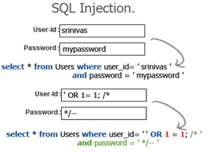
Introduction
What?
Literature research and survey paper on DBMS threads, vulnerabilities, and attacks.
Why?
Importance of data C. I. A.
Increasing number of threats and
attacks.
How?
Literature review and classification.

Slide 37


Elevator-Pitch
SQL Injection
Brute force
Privilege escalation
Platform vulnerabilities
Literature review and classification on the most popular DBMS cyber attacks.
Effective countermeasures: IDSs.
Classification of DBMS based on vulnerabilities.
Research survey paper.

Slide 38
Deliverables
What to expect at the end?
A survey on Intrusion Detection Systems (IDS) for DBMS.
What is your contribution?
Literature review on different attacks and threats. Countermeasures.
Classification of DBMS based on vulnerabilities.
How many hours a week starting today would you spend in this project?
~10 hours.
How does this measures the outcome?
Survey paper.
How many references would you have?
~ 40.

Slide 39
COP 5725
A Survey on Intrusion Detection Systems for DBMS
Abbas Acar, Leonardo Babun, Amit Kumar Sikder
Cyber-Physical Systems Security Lab (CSL)

Slide 40
Introduction
What?
A survey on intrusion detection systems (IDS) for database management system.
Why?
Guarantees the C. I. A. of users, business, and government data.
Increasing number of threats and malicious attacks.
Different techniques available to detect different attacks.
How?
Literature review and classification.

Slide 41

Elevator-Pitch
Literature review of different intrusion detection systems on database management system.
Classification of IDSs available for DBMS based on features, techniques, etc.
Comparison of different IDSs.
Shortcomings of different IDSs against different types of attacks.

Slide 42
Deliverables
What to expect at the end?
A survey on Intrusion Detection Systems in Database Management.
What is your contribution?
Literature review of IDSs and classify them according to features, techniques, etc.
Shortcomings of different approaches.
How many hours a week starting today would you spend in this project?
10 hours.
How does this measures the outcome?
Survey paper.
How many references would you have?
~ 40.

Slide 43
COP 5725
School of Computer and Information Sciences
Li Li 6052180
A Framework for Distributed Transactions over RESTful Services

Slide 44
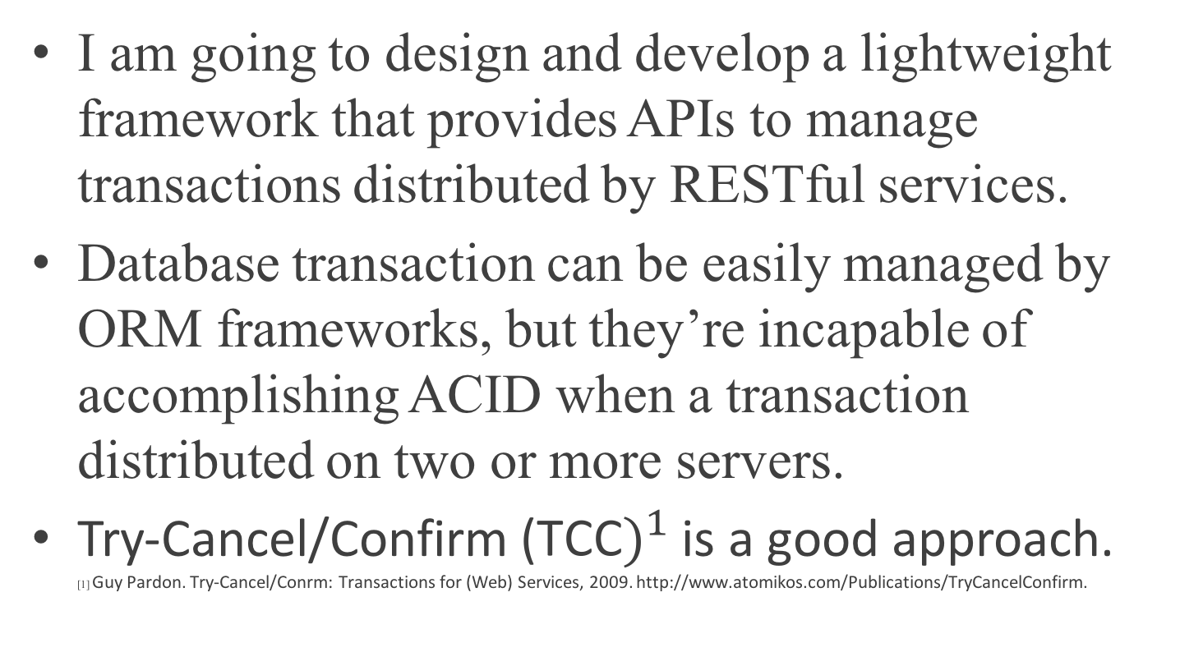
Introduction
I am going to design and develop a lightweight framework that provides APIs to manage transactions distributed by RESTful services.
Database transaction can be easily managed by ORM frameworks, but they’re incapable of accomplishing ACID when a transaction distributed on two or more servers.
Try-Cancel/Confirm ${\text{(}\text{TCC})}^{1}$ is a good approach. [1] Guy Pardon. Try-Cancel/Conrm: Transactions for (Web) Services, 2009. http://www.atomikos.com/Publications/TryCancelConfirm.

Slide 45
Elevator-Pitch
This project is an implementation based on papers about distributed transactions and the TCC approach, it’s a Java framework provides annotations and APIs to manage distributed transactions over distributed RESTful services that follow the TCC protocol.

Slide 46
Deliverables
I am going to deliver a well tested Java framework, and a technical document about it.
14 hours a week work on this project.
The outcome would be measured by:
1. Is the design of the framework follows TCC protocol.
2. Does the framework completely implemented.
I have 10 references.

Slide 47
COP 5725
School of Computer and Information Sciences
Mireya Jurado
Encryption on the Cloud:
Mapping Relational Algebra to Leakage Channels

Slide 48








Secrets on the Cloud
We want to use the cloud for storing sensitive information, but currently, it’s not safe.
Traditional encryption is not useful for database searches.
Solution: Use alternative encryption method.
We don’t know which method is safest!
Notes:
Hospitals, governments, and legal services want to use the cloud
The channels aren’t safe and we can’t trust the providers
We can encrypt it
But we want to search through it
Use alternative form of encryption

Slide 49


Compare Encryption Methods
Short term: Map relational algebra primitives to leakage framework
Long term: Assess information leakage between different types of encryption methods
Determine which method is safer, and under what circumstances.
Notes:
Short term: Map relational algebra primitives to leakage framework
Long term: Assess information leakage between different types of encryption methods
There are lots of ways to weaken encryption
Order preserving encryption
Deterministic encryption
Find the safer one!
Start on this larger goal.
Since relational databases are fundamentally based on relational algebra, we can use these properties to compare the different types of encryption.
From here, we can determine which type is safer, and under what circumstances.

Slide 50
Deliverables
Future Work
4-8 page research paper
15-40 references
~10 hours a week
Contribution: The project will be my work with input from my lab
Expectation: A starting point for future research
Determine safer method
Implement the safer method
Encrypt on the cloud!
Safer database storage for everyone
Notes:
What do I expect: a starting point for future research on this topic. The beginning of that first box with the end goal of safer database storage for everyone
Map relational algebra into channels
Map the primitive operations of databases into a leakage framework
Turn the basic database operations into a format that can be probabilistically tested
Determine which type of database encryption is safer and under what circumstances
Compare the leakage of these channels
Implement the safer method
Encrypt on the cloud!

Slide 51
COP 5725
School of Computer and Information Sciences
Pedro. {Pedro Soto}
Pedro
A vista of B-tree locking mechanisms

Slide 52
Introduction
It is a discussion of concurrency control in the b-tree data structure.
B-trees are a ubiquitous data structure that are a generalization of binary trees.
Different methods for handling concurrency are surveyed.

Slide 53
Elevator-Pitch
B-trees are a ubiquitous data structure that are a generalization of a binary tree. They allow for a node to have an arbitrary maximum number of children. Concurrency control is an important and basic question for any data structure. It turns out that concurrency control can be quite difficult in B-trees.

Slide 54
Deliverables
I expect to learn how to use an important data structure.
I hope to use this knowledge to further my research.
I expect to contribute 9 hours a week.
I expect 9 nine is a reasonable amount of time to accomplish my goal.
I currently have two resources.

Slide 55
COP 5725
School of Computer and Information Sciences
Mr. Tooth Ruizhang Zou
Ruizhang Zou
The Status Quo and Trend Research of Database Security

Slide 56
Introduction
What is it?
It's a reasearch and an analysis about what situations database security is in and what the situations will be in the future.
Why is it important?
This report may call more attention to database security field.
How? (Methodology)
Firstly, collect amount of articles about cyber security. Analyze them with hadoop wordcount. Finally, Use the results, combined with some real events to get conclusions

Slide 57
Elevator-Pitch
1.Introduction
1.1 How to do hadoop wordcount
1.2 How to analyze the wordcount results
1.3 Why are the wordcount results reliable
2.Database security situation in cyber security
2.1 The situation of database security
2.2 How important the database security is compared with other security fields
3.The trends of database security
3.1 Database in the future
3.2 Trade demand analysis

Slide 58
Deliverables
What to expect at the end?
We may conclude that the situation of database sequrity will become severe and need to develop new functions and ideas to fit future database environment.
What is your contribution?
A wordcount result txt and a paper report about the database security.
How many hours a week starting today would you spend in this project?
I'm not sure because I have to inplete hadoop wordcount first. But at least one or two hours per day.
How does this measures the outcome?
By frequency, the more a word be mentioned, the more this word should be paied attention.
How many references would you have?
I already collected 415 articles about cyber security.

Slide 59
COP 5725
School of Computer and Information Sciences
Sara Wilson
Designing a Webpage to Query from a Database

Slide 60


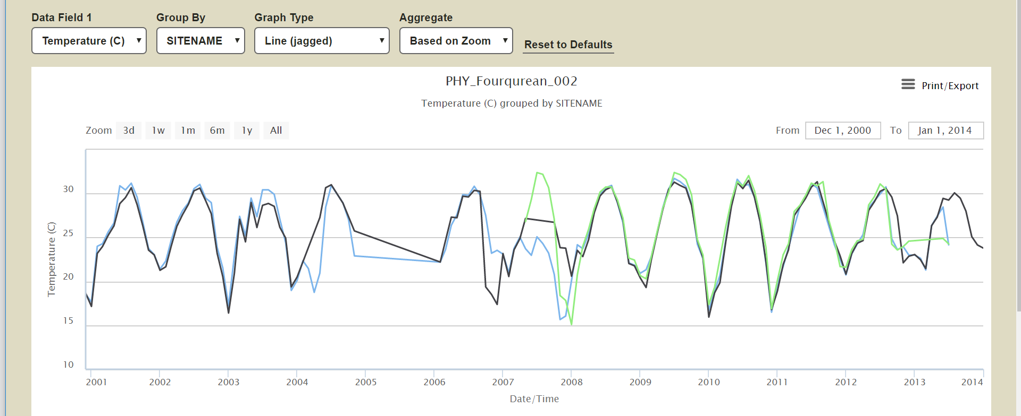
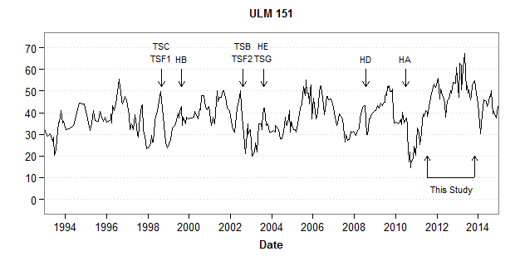
Challenge:
Our lab stores seagrass monitoring data in an Access database. How can I design a webpage that will display results
from a user-defined
(‘dynamic’) query to our dataset?
Applicable to any environmental monitoring dataset, and beyond…
Notes:
Why is it important? How?(Methodology)

Slide 61
Approach:
1- Split Access database into a front-end and back-end
2- Store back-end of database on SQL Server
3- Make back-end of database available for web queries (PHP?)
4- Program webpage to graphically display query results (Highcharts javascript library?)
Notes:
Why is it important? How?(Methodology)

Slide 62
Deliverables:
-Split database into front-end and back-end (topic presentation)
-Make webpage that can “talk” to the database
-Option 1: Results of user queries output into tables or .csv
-Option 2 (ideal, more difficult): Results of uses queries plotted as a line graph
Notes:
What to expect at the end? What is your contribution? How many hours a week starting today would you spend on this project? How does this measure the outcome? How many references would you have?

Slide 63
COP 5725
School of Computer and Information Sciences
Group Torres Tang. Nicholas Torres, Wenbing Tang
Wenbing Tang
Exploring Distributed Databases
Notes:
63

Slide 64
Introduction
Implement and demonstrate a DDBMS
Growing industry adoption
High availability
Scalability
Implementation:
Provider
DDBMS
Feature Demonstration
Notes:
64

Slide 65
Elevator-Pitch
Data is growing at an incredible pace
Traditional methods are cumbersome
Notes:
65

Slide 66
Deliverables
Small scale system with 3 or 4 nodes
10 hours every week
Outcomes
Runnable
Comprehensive Documentation
10+ References
Notes:
66

Slide 67
COP 5725
School of Computer and Information Sciences
Group Torres Tang. Nicholas Torres, Wenbing Tang
Nicholas Torres
Exploring Distributed Databases
Notes:
67

Slide 68
Introduction
Implement and demonstrate a DDBMS
Growing industry adoption
High availability
Scalability
Implementation:
Provider
DDBMS
Feature Demonstration
Notes:
68

Slide 69
Elevator-Pitch
Global Infrastructure
Surviability
Companies are moving towards DDBMS
Notes:
69

Slide 70
Deliverables
Contribution
Group and Individual Tasks
Completed and Future Tasks
Notes:
70

Slide 71
COP 5725
School of Computer and Information Sciences
Team: Chopsticks Members: Wentao Wang, Bingqian Li
A survey of semi-structured and unstructured data storage, maintenance and analysis

Slide 72
Introduction
What is it?
Semi-structured and unstructured data are two data types.
Why is it important?
Semi-structured and unstructured data can be seen everywhere in our society.
How? (Methodology)
Find some paper about semi-structured and unstructured data, and study how to store and maintain them.

Slide 73
Elevator-Pitch
In this project, my job is to study the storage and maintenance of semi-structured and unstructured data. At first, I need to read huge number of paper about this topic, then I will summarize the main content of these paper, and finally, I will write a survey about this topic. My aim is to display the ways of storage and maintenance, advantages and disadvantages of each methods.

Slide 74
Deliverables
What to expect at the end?
Submit a research survey.
What is your contribution?
Finish the data storage and maintenance part.
How many hours a week starting today would you spend in this project? 2 hours.
How does this measures the outcome?
Ask some professors to see the survey and record their suggestions.
How many references would you have? 50.

Slide 75
COP 5725
School of Computer and Information Sciences
Team: Chopsticks Members: Wentao Wang, Bingqian Li
A survey of semi-structured and unstructured data storage, maintenance and analysis

Slide 76
Introduction
What is it?
Bug report is a typical semi-structured and unstructured data, and it very common in software domain.
Why is it important?
Analyzing bug reports can help engineers quickly find the useful information, which will be helpful for maintaining the system.
How? (Methodology)
Collect related research paper and read them carefully.

Slide 77
Elevator-Pitch
I will focus on the part of analyzing semi-structured and unstructured data. Here, a typical type of semi-structured and unstructured data, bug reports, will be selected to study. Specifically, I plan to investigate how the current machine learning and data mining methods used to analysis bug reports. I will describe the definition of these methods, provide the comparison between these methods, and study how to modify these methods so that they can be applied to bug reports analysis area better.

Slide 78
Deliverables
What to expect at the end?
Complete a research survey.
What is your contribution?
Finish the data analysis part of the survey.
How many hours a week starting today would you spend in this project? 2 hours.
How does this measures the outcome?
Sent the completed survey to some professors and see their feedback.
How many references would you have? 50.

Slide 79
COP 5725
School of Computer and Information Sciences
Research of Hive data warehouse
Yezehao Huai
PID:5965823
yhuai001@fiu.edu

Slide 80
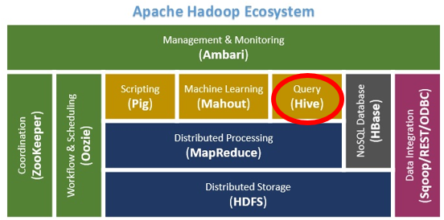
Introduction
Apache Hive is a data warehouse software project based on Apache Hadoop and HDFS for data query, summarization and analysis. Hive QL is a SQL-like declarative language to compile queries expression into Map-Reduce jobs executed on Hadoop.
Problems:
-44 x 10¹² gigabytes per day
-Focus on analysis results
-Need low cost of analysis, storage and high scalability database towards big data
-Map-Reduce is hard to learn and program for numerous users
Solution: Hive

Slide 81
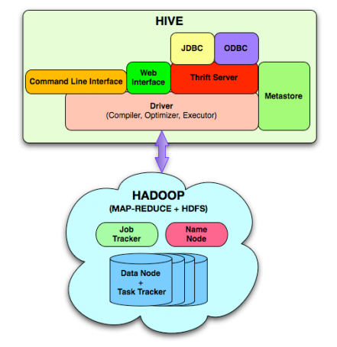
Elevator-Pitch
Principles
-Data warehouse concept
-Map-Reduce + HDFS
-Operating mechanism
Features & Optimization
-Hive vs Traditional database
-Hive QL
-Table Compression/Index/Execution Plan
Business Analysis
-Calculate the trend
-Analyze massive offline Web logs
-Web logs data warehouse

Slide 82
Deliverables
A research paper (25-35 references)
Time line (12 hours per week)
-Sep.23~Oct.6 : Proposal
-Oct.6~Oct.21 : Related work, technical principle research
-Oct.21~Nov.10 : Implementation of Hive
-Nov.10~Nov.23 : Final project report and experiment result
Contributions
-Related to my work
-Related to the Part 10(chapter 23, 24, 25) of course textbook
-Related to big data technical community

Slide 83
COP 5725
School of Computer and Information Sciences
Thank you all
Please submit your forms (individually)

